Slide 1
Automating Report Solution for a Leading Equipment Manufacturer
Our Success Story With Camunda Process Orchestration
Notes:
Process Orchestration

Slide 2



Content
About SURGE
Success Story
Demonstration
2

Slide 3
About Surge
About Surge

Slide 4
About Customer/Success Stories
A world’s largest manufacturer of construction equipment firm with headquarters in Irving, Texas. The client's operations span around 50 countries in emerging markets, with over 100 thousands employees from more than 50 different countries

Slide 5
Business Challenges
The customer finding difficulties to construct a centralized platform by using microservices-based business processes to collect data from more than 10 different end points for generating reports that is predominantly serving their business purpose.
Client's business looking for solution that can provide smooth collaboration between IT and non-technical stakeholders for designing , implementing and improving complex E2E business process.
Digital Transformation leads our customer to look for solution that can ensure scalability and resilience.
Frequent Rule Condition/Configuration changes involves the customer to come across multiple reduntant deployment procedures and they were looking for solution which can be loosely coupled with the business rules.

Slide 6
Customer ASKs
Developer can build configurable process models and business team can change and implement based on the dynamic needs of the business.
Customer needs LOW-CODE platform to serve them for developing a new REPORT-GENERATION in quick turn-around time.
Customer needs an OPEN-ARCHITECTURE platform that can provide Integration Framework for integrating easily with most common technical architectures and frameworks
Generating Report for nearly 160 thousands records in quick time is the predominant ask from the Client where their current solution failed to meet this requirement.

Slide 7
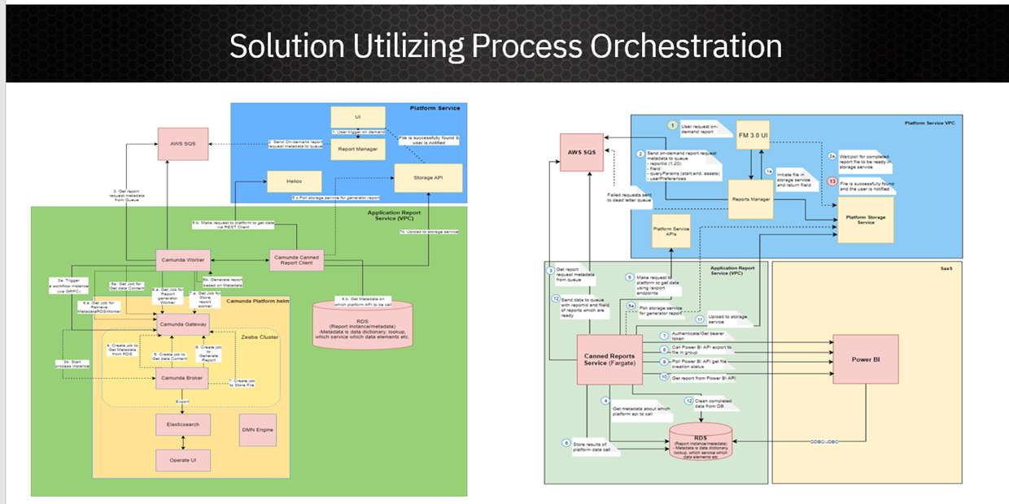
SURGE Solution
SURGE’s solution is implemented using BPM and SOA technologies to provide centralized BPM platform and improve agility.
Redesigned the solution with Camunda 8, DMN (Rule Engine), Customized Inbound/Outbound Connectors, Elastic Search
Used Camunda 8 as an overall process orchestration tool for collecting and aggregating the data that is required to generate more than 60 different report types in quick time.
Our solution brought in the Event Driven Mechanism to trigger the Report Generation Process.
The solution built in with customized inbound web-hook connector to integrate the Amazon SQS with Zeebe Engine.
With the help of SOA mechanism, the solution exposed DMN Rule Engine as a CENTRALIZED SERVICE PLATFORM where the rule definitions re-used across the business process.
We built nearly 7 to 8 customized CONNECTORS which serve the purpose to define workflow templates where the business team can configure for their needs.
Elastic Search added more value to our solution which serves the primary purpose to store the huge report data(get the size from joel) temporarily as zeebe can handle data size max 4 MB.
The solution get deployed in AWS EKS platform to meet customer's need in terms of SCALABILITY, FLEXIBILITY.

Slide 8
Business Impact
Reduced Development time:
Nearly 40% of logic has been moved as reusable components (Connectors) that can be used across the report generation and reduced the development cycle time from 70 hrs to < 30 hrs per report development.
Flexibility:
BUSINESS RULES AS SERVICE facilitate the Business Users to update the business rules without re-deploying the complex workflows again and again.
Handling Huge Data:
Around 160 thousands records were processed , formatted and report get generated in quick time made the customer to add the ON-DEMAND report generation feasible.

Slide 9
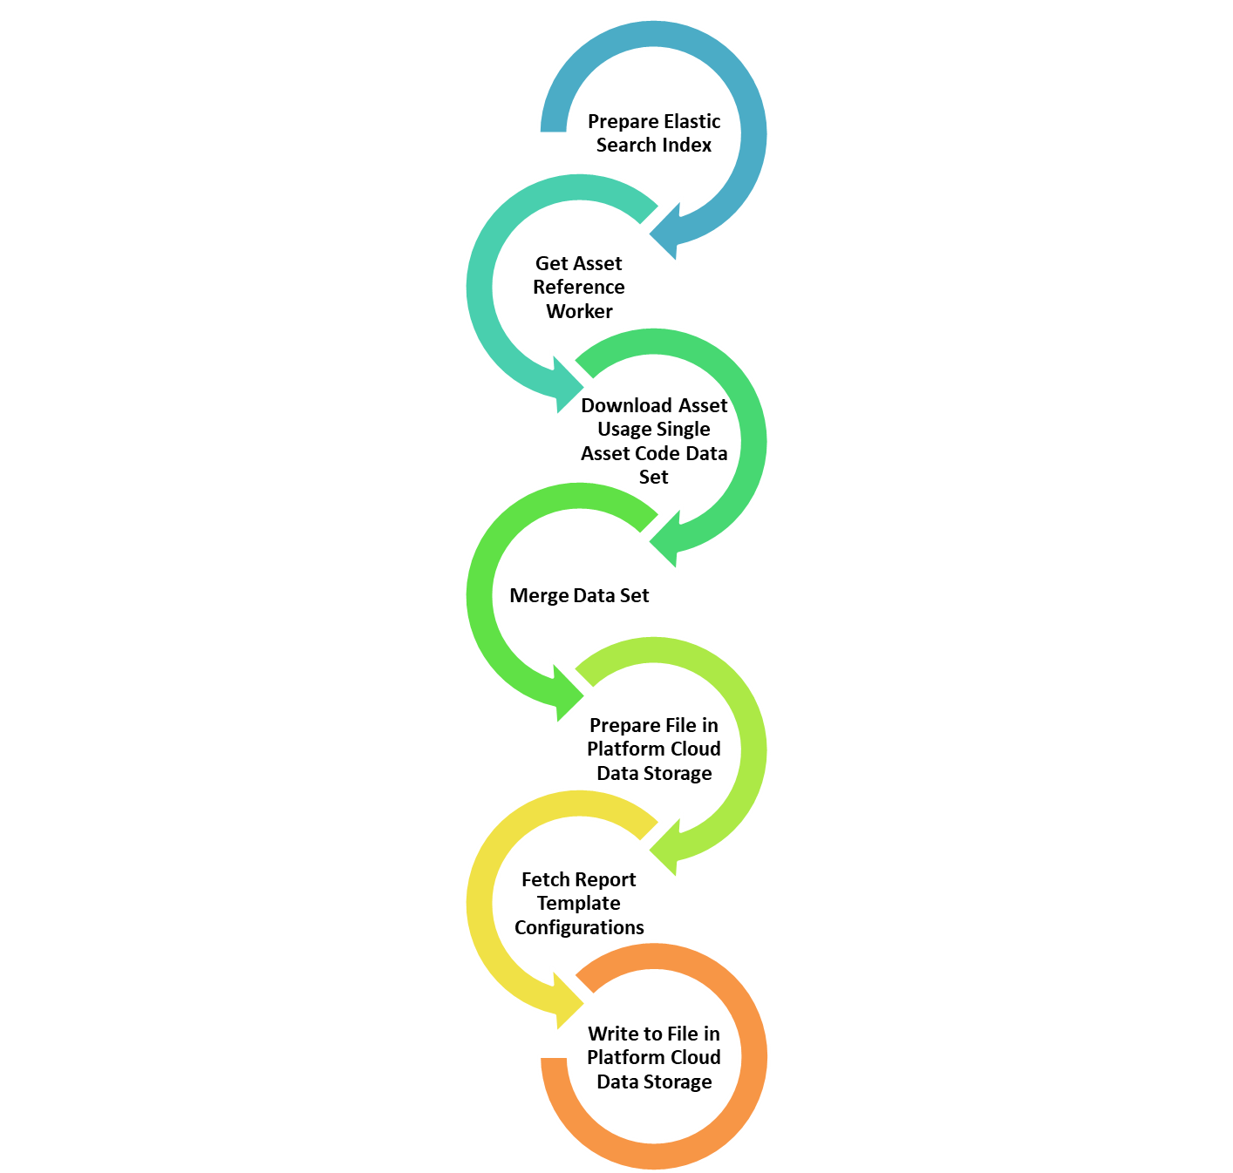
Product Use Case – Incomplete (Duy Trong)
CAMUNDA SOLUTION USE CASE
Asset Management Report
ASSET USAGE SINGLE ASSET REPORT:
Description about the Use Case: (if possible use case diagram)
Description about the architecture
Workflow diagram
High Level Seq Diagram

Slide 11

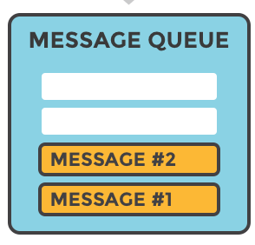
ON-DEMAND REQUEST
SCHEDULED REQUEST
REPORT MANAGER

Slide 12
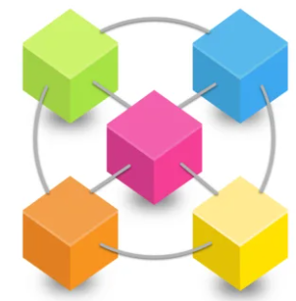

Slide 13

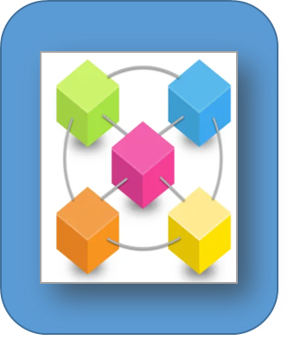
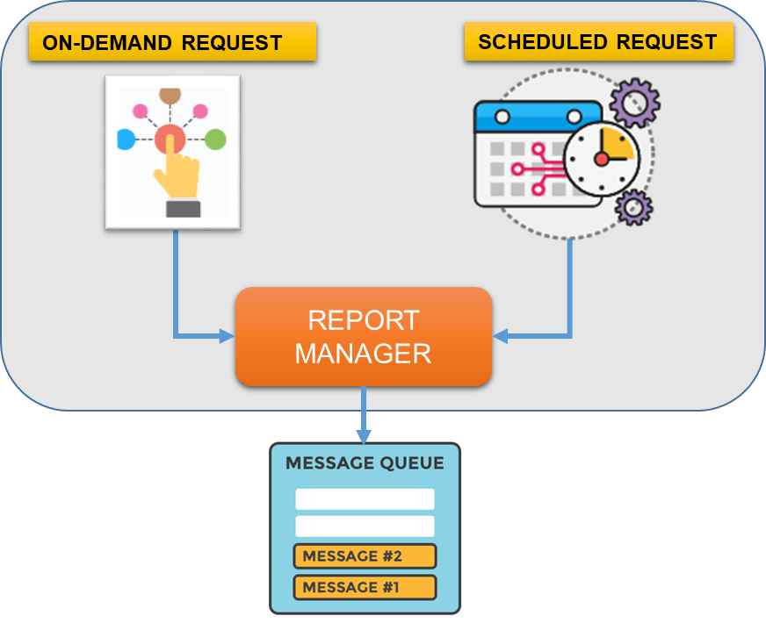

Custom Connectors
DMN AS Service
EXTERNAL APP
SERVICE PLATFORM
EXTERNAL APP
ZEEBE CLUSTER
JOB WORKERS
JOB WORKERS
BROKER
JOB WORKERS
GATEWAY
BROKER
Distribute
BROKER
ELASTIC SEARCH
CAMUNDA OPERATE

Slide 14
Custom Connectors
DMN AS Service
EXTERNAL APP
SERVICE PLATFORM
EXTERNAL APP
ZEEBE CLUSTER
JOB WORKERS
JOB WORKERS
BROKER
JOB WORKERS
GATEWAY
BROKER
Distribute
BROKER
ELASTIC SEARCH
CAMUNDA OPERATE

Slide 15


